Slide 1

An Epidemic of Healthcare Cyberattacks
Colby G, George K, Mayur S, Andrew R

Slide 2
Looking Ahead:
HIPAA Privacy Rules
Casualties
Hackable Health Equipment
Vulnerable Powergrid consequences

Slide 3

HIPAA Privacy Rule

Slide 4
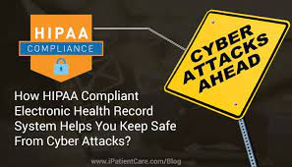
HIPAA "Checklist"
Conducting risk analysis.
Implementing procedures to detect and guard against malicious software.
Training users on malicious software protection.
Limiting access to ePHI;
Maintaining an overall contingency plan including disaster recovery, emergency planning, etc.
Understanding ransomware.

Slide 5
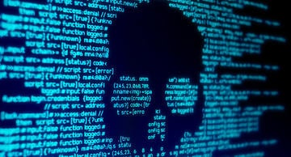
Hospital Hackings

Slide 6
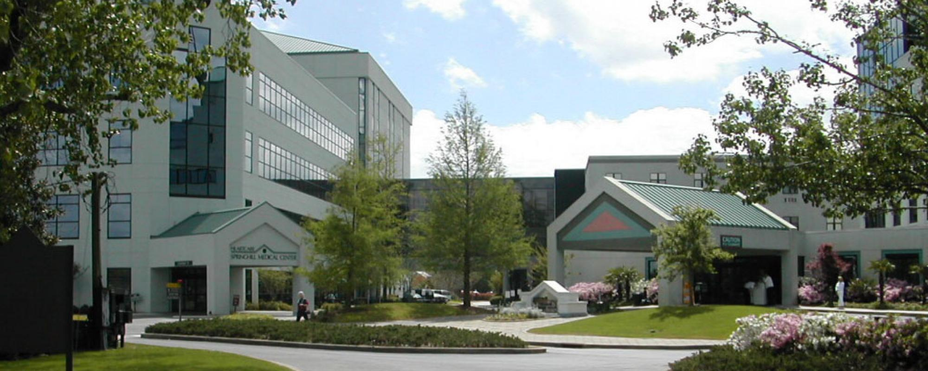

Slide 7
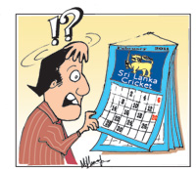

Slide 8
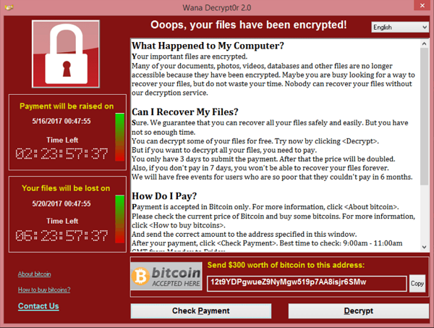

Slide 9
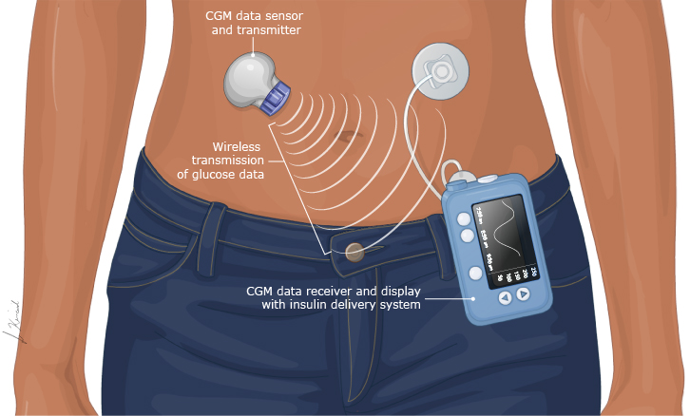
Hackable Health Equipment
CNN reported that research has shown that nearly 4,000 devices are running on vulnerable

Slide 10
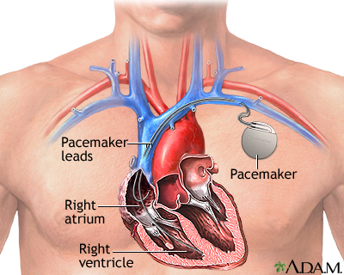

Slide 11
​Power Grid Hacked ​
"A reliance and dependence on technology in our everyday life has led to a serious vulnerability that cybercriminals can exploit" -Diana Sanchez
In 2015, a Russian attack on Ukrainian energy companies left over 225,000 customers without power for several hours

Slide 12
​Power Grid Hacked ​
Medical records
Food, water, and transportation
Powered wheelchairs and ventilators
Implanted cardiac devices
Life support systems
Environmental controls

Slide 13
​Wrapping Up

Slide 14
Citations
https://www.nbcnews.com/news/baby-died-due-ransomware-attack-hospital-suit-claims-rcna2465
https://www.theverge.com/2021/9/27/22696097/hospital-ransomware-cyberattack-death-rates-patients
https://www.theverge.com/21551050/cyberattacks-hospitals-coronavirus-deadly-tactics
https://www.aamc.org/news-insights/growing-threat-ransomware-attacks-hospitals
https://expeditiorepositorio.utadeo.edu.co/bitstream/handle/20.500.12010/2713/FINAL%20THESIS%20DIANA%20SANCHEZ.pdf?sequence=1&isAllowed=y
https://www.cfcs.dk/globalassets/cfcs/dokumenter/trusselsvurderinger/en/the-threat-of-destructive-cyber-attacks.pdf
https://www.fema.gov/sites/default/files/2020-07/healthcare-facilities-and-power-outages.pdf
https://www.theverge.com/2019/10/28/20932780/california-blackout-healthcare-electricity-fires

